Slide 1
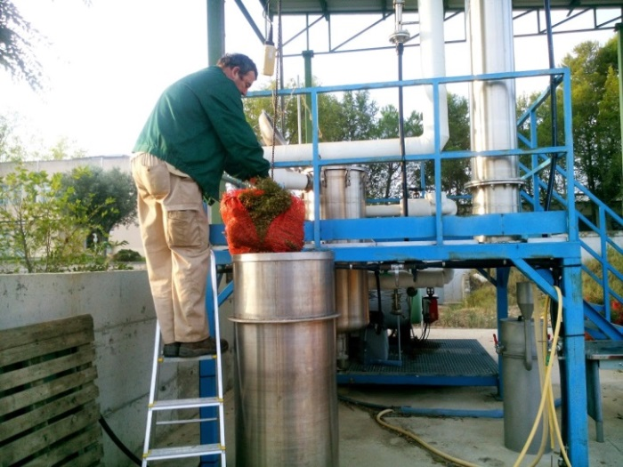
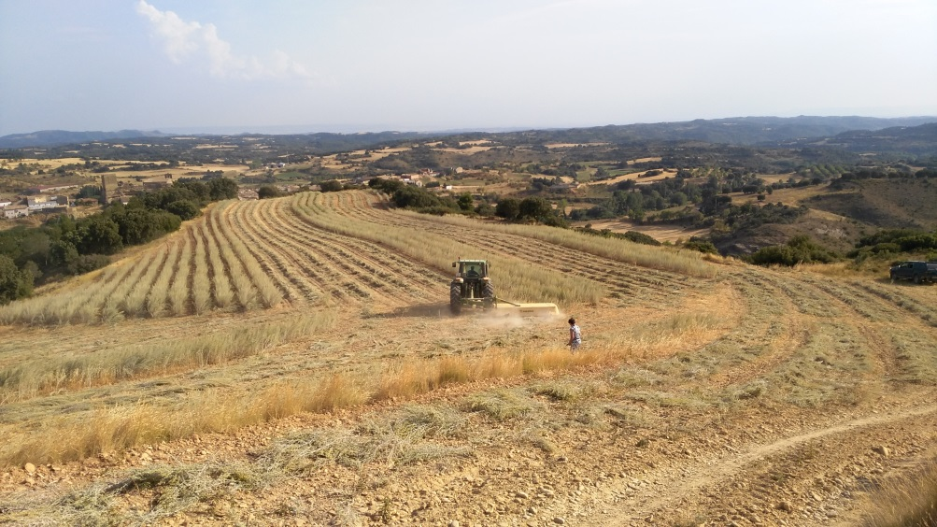
Conference “Natural products for crop protection” – CSIC /CITA
The Biopesticides Research Group from Institute of Agricultural Science (ICA-CSIC) organized the Conference “Natural products for crop protection” that took place on 14th and 15th of June 2019 at the Center for Research and Agri-Food Technology of Aragon (CITA). Up to forty attendees participated in this event, most of them researchers and doctoral students from CITA, students from School of Agronomists of Aragon (Spain), as well as agricultural technicians and farmers. CITA collaborated with the CSIC Biopesticides group with their testing fields of aromatic plant crops and the extraction pilot plant located in their facilities, which were visited during the first day. After the visit, a series of project presentations were hold. The next day took place the workshop on aromatic and medicinal plants and their essential oils, with a series of talks on domestication and in vitro cultivation of aromatic plants (Aleovitro), biocidal compounds of essential oils (University of Granada), initiatives with aromatic plants in the Iberian southwest (CTAEX) and field domestication of aromatic plants (CITA).

Slide 2
LIFE Project “Waste4Green”: Sustainable and green agri-waste based biopesticides
The Biopesticides Research Group (ICA-CSIC) coordinates the LIFE Project “Waste4Green”, which is focused in the use of agricultural waste to produce biopesticides. During the life of this project, the efficacy of two natural, safe and sustainable new formulations will be demonstrated. The raw materials are obtained from agro-industrial by-products. The field experiments are expected to start this year. To find out more about the project you can visit the website https://waste4green.eu/

Slide 3
Erasmus+ project (BET) “Biocontrol e-training”
The Erasmus+ project “Biocontrol e-training - BET” is developing a new online training tool on biocontrol, aimed at a wide variety of groups (training organizations, universities, technical institutes…). First, a comprehensive study about biocontrol’s training need was made through the EU. Once the necessities were stablished, four e-learning modules about biocontrol were developed (available in four languages: EN, FR, IT, ES), as well as a learning management system. Now that the project is coming to an end, a comprehensive guide of the project, including its results, is being elaborated. For further information about the project, you can visit the website http://www.e-biocontrol.com/ and for the online learning platform you can sign up free in https://mygreentrainingbox.com/

Slide 4
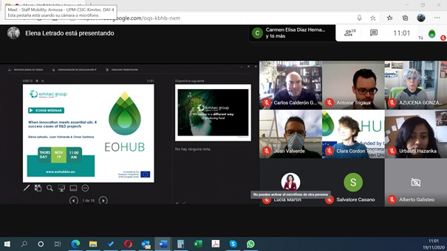
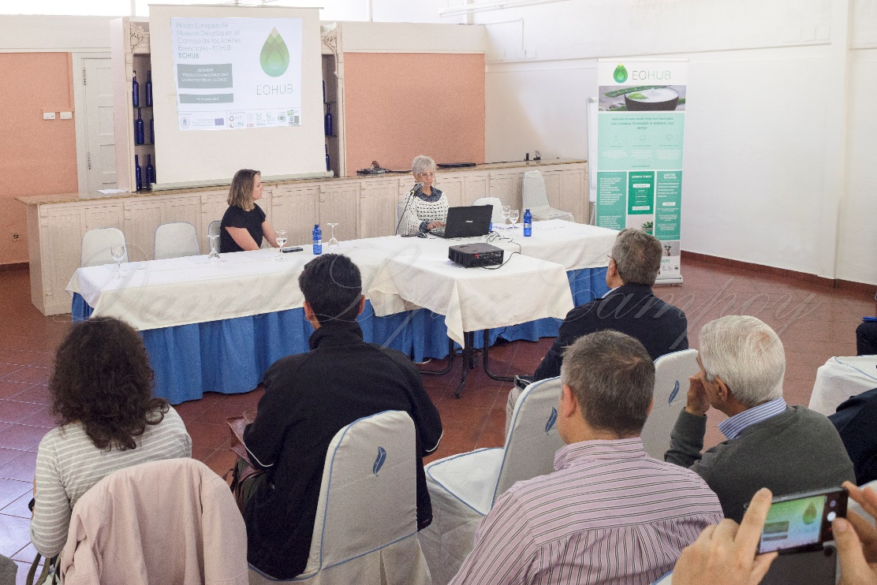
Erasmus+ project (EOHUB) “European Hub on Essential Oils”
Another Erasmus+ project that the Biopesticides Research Group (ICA-CSIC) is part of is EOHUB, an European conglomerate centered in the field of Essential Oils. This project aims to increase the capacity of higher education institutions and business to integrate research results and innovative practice into the educational offer, and to exploit the potential for marketable process, methods and services in the field of essential oils and medicinal and aromatic plants. Moreover, it helps graduates and PhD students to develop new entrepreneurship activities and marketable services in line with their curricula, which too often remain only at the level of “theoretical applications” and “case studies”. A series of staff mobility encounters are being made, starting with the virtual visit of ARMOSA TECH to ICA-CSIC installations. It was an opportunity to share knowledge and strengthen relationships between research laboratories and industry. In the framework of the dissemination of staff mobility activities, the project coordinator, the Polytechnic University of Madrid (UPM) held the webinar “CYCLE OF CONFERENCES EOHUB - EUROPEAN HUB IN THE FIELD OF ESSENTIAL OILS”. Although it is an EU funded project, anybody from all over the world can join the webinars and participate in the “learn&teach” platform, available in the website https://eohubbio.eu/

Slide 5
i-COOP+ Project “Valorization of Colombian agroforestry residues”
The Biopesticides Research Group CSIC collaborates with the University of Antioquía in Colombia through the I-COOP program “Valorization of Colombian agroforestry residues: a training tool in biocontrol and circular economy”.
The purpose of the CSIC Program for Scientific Cooperation for Development i-COOP+ is to promote the achievement of the Sustainable Development Goals (SDG) and contribute to the strengthening of scientific-technical and training capacities of countries receiving ODA (Official Development Assistance) through the training and exchange of knowledge of scientific and technical personnel in ODA countries.

Slide 6
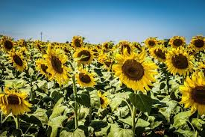
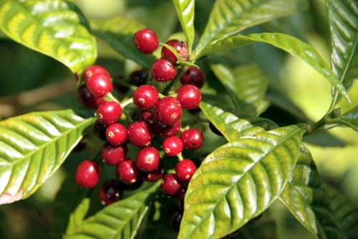
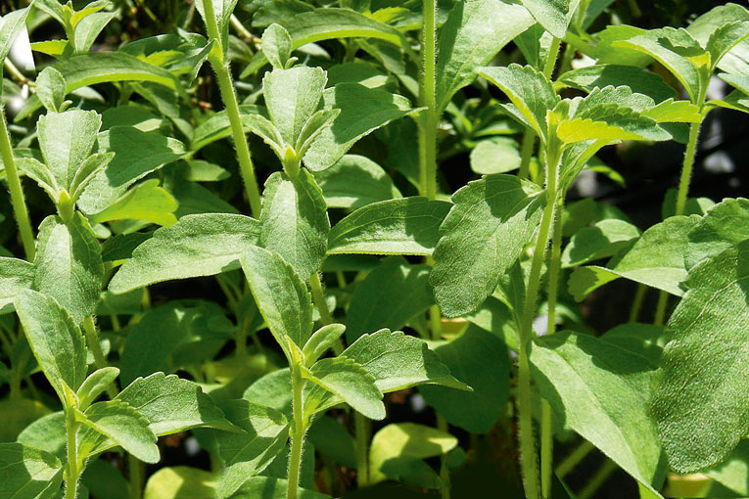
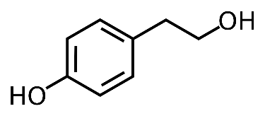
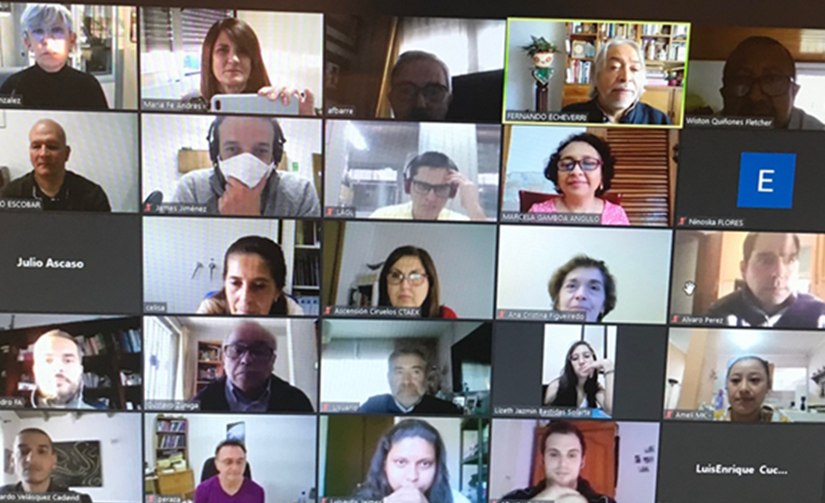
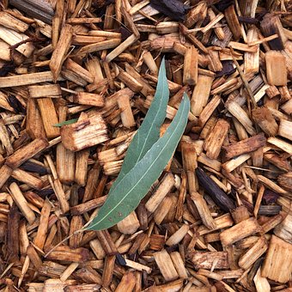
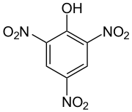
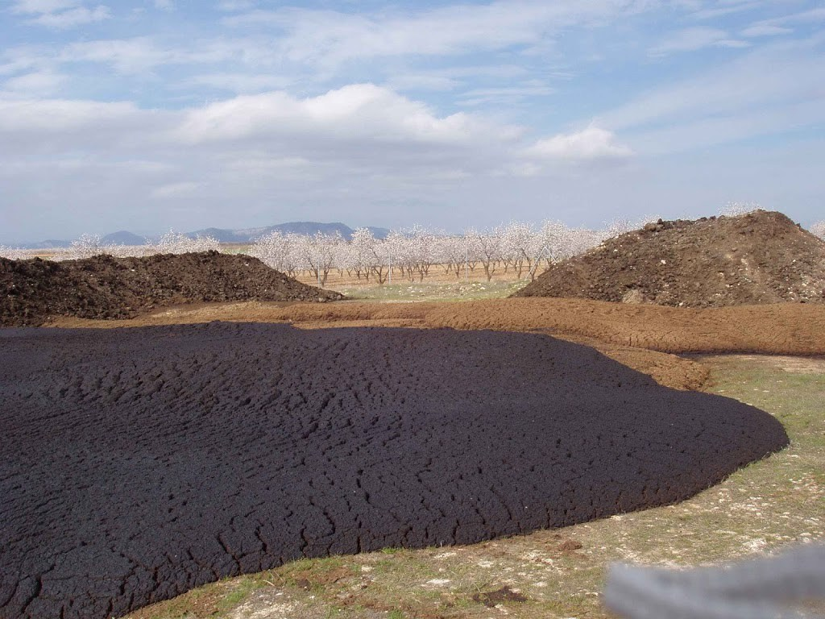
Webinar "Exploitation and use of natural substances in agroforestry residues"
Aprovechamiento y uso de sustancias naturales en residuos agroforestales
CSIC / Universidad de Antioquia
As part of the I-coop collaboration Programme, we organized the Webinar "Exploitation and use of natural substances in agroforestry residues" in November 2020.
We had participants from different countries countries (Spain, Mexico, Chile, Colombia, Brazil, Portugal) with great interest in the topics (see programme in the next slide)
23- 25 de noviembre de 2020
PROYECTO I-COOP (B20369)

Slide 7
 | LUNES 23 DE NOVIEMBRE
9:15-9:30 | Inauguración (F. Echeverri, Univ. Antioquia y A. Gonzalez Coloma, CSIC)
 | Residuos Agroforestales: problemática ambiental y oportunidades
9:30-10:00 | M.F. Andrés, CSIC Residuos agroindustriales como fuente de productos nematicidas. Proyecto LIFE WASTE4GREEN
10:00-10:30 | F. Echeverri, QOPN Univ. Antioquia Aspectos químicos de los residuos agroindustriales de Café, Flores, cítricos, Banano, Palma. Aprovechamiento de residuos de maderas colombianas. Proyecto ICOOP
10:30 -11:00 | DESCANSO
11:00 -11:30 | C.E. Diaz, CSIC Residuos del aceite de oliva y aplicaciones biotecnológicas ()
 | MARTES 24 DE NOVIEMBRE
8:30-9:00 | G. Zúñiga, Univ. Santiago de Chile
 | Oportunidades de aprovechamiento de residuos en América Latina: el caso de Chile
9:00-9:30 | Edison Osorio, GISB Univ. Antioquia El potencial farmacéutico de los desechos agroindustriales.
9:30 -10:00 | DESCANSO
10:00 -10:45 | J.Fco Quilez-A.F.Barrero, Univ. Granada Dittrichia viscosa Greuter: Fuente de Diversidad Molecular para el Desarrollo de Plaguicidas
 | MIERCOLES 25 DE NOVIEMBRE
8:30-9:00 | W. Quiñones, QOPN Univ. Antioquia Diseño de moléculas activas basadas en modelos naturales de residuos. Proyecto ICOOP
9:00-9:30 | G. Escobar, QOPN, Univ. Antioquia Estevia como fuente de leishmanicidas
9:30 -10:00 | DESCANSO
10:00 -10:30 | J.Á. Rufián-Henares- A.F. Arteaga, Univ. Granada Valorización integral de residuos y subproductos del café. Aplicaciones como agentes prebióticos y en biofortificación de alimentos.
10:30-11:00 | Alvaro Pérez, Univ. Granada) Residuos del Girasol (Helianthus annuus L.): Diversidad Molecular y Potencial Plaguicida

Slide 8
SIMPOSIO DE INVESTIGACIÓN EN PRODUCTOS NATURALES BIOACTIVOS: “INNOVACION EN BIOPLAGUICIDAS Y FARMACOS DESDE RESIDUOS AGROFORESTALES, PLANTAS Y MICROORGANISMOS” Noviembre, 2021 Granada"
Aprovechamiento y uso de sustancias naturales en residuos agroforestales
The next I-Coop meeting has been planned for November 2021 and will include online and face-to-face sessions.
We are organizing this event in collaboration with the University of Granada with the support of the I-Coop-CSIC project, the Spanish Royal Society of Chemistry (GPN-RSEQ) and the company KIMITEC.
The venue will be at the University of Granada.
Three excellence awards supported by Kimitec for research in green agriculture and biopesticides will be granted during this Symposium.
For further information about these conferences, see preliminary programme below
Contact: Biopesticides Research Group CSIC (azu@ica.csic.es).

Slide 9
Aprovechamiento y uso de sustancias naturales en residuos agroforestales
SIMPOSIO DE INVESTIGACIÓN EN PRODUCTOS NATURALES BIOACTIVOS: “INNOVACION EN BIOPLAGUICIDAS Y FARMACOS DESDE RESIDUOS AGROFORESTALES, PLANTAS Y MICROORGANISMOS” Noviembre, 2021 Granada DIA 1: Inauguración 16.15 A)- Residuos Agroforestales oportunidades: 16.30 Silvicultura. Residuos maderas colombianas: 1 (Fernando Torres-UDEA)
17.00 Residuos de la producción de aceite oliva: 2 (I. Garcia Romera EEZ-CSIC, MAFA).
18.00 3 Productos Naturales Bioactivos Contenidos en los Residuos de la Industria Oleícola. Derivatización y Propiedades Biológicas. (A. Parra-UGR). 18.30 4 Valorización integral de residuos y subproductos del café. Aplicaciones como agentes prebióticos y en biofortificación de alimentos. (José Ángel Rufián-Henares, Alejandro Fdez Arteaga, UGR)
19.00 5 Residuos de la agroindustria de café, hortícolas y plantas medicinales Colombianas.(F. Echeverri-UDEA)
DIA 2
B)-Plantas Arómatico-Medicinales (PAMS) para la obtención de PN Bioactivos
9.00 6 Domesticación de especies productoras de PNs (J.Rocha-CITA,)
9:30 7 Producción Biotecnológica de PAMS. (Carmen E. Diaz, IPNA-CSIC; E. Ochoa-AleoVitro)
10:00 8 Residuos de la extracción de PAMS y aplicaciones (M. F. Andres, ICA-CSIC) 10.30 9 Estrategias de Extracción y Purificación de Bioactivos. Escalado (A.Fernandez Barrero-UGR).
11.00 10 Modelos estructurales de sustancias bioactivas en PAMS. (J. Quilez-UGR).
11:30 Café+ Sesion Poster
Optimizacion de la producción de sustancias bioactivas de residuos:
12.30 12 Compuestos bioactivos de residuos de maderas, FE-UDEA, AG-CSIC 13.00 13 Modelos estructurales de sustancias bioactivas en maderas. (W Quiñones-UDEA).
C)-Búsqueda de Fármacos y Plaguicidas en Microorganismos:
15.30 14 Metagenómica de plantas como herramienta de búsqueda de endófitos (hongos/bacterias) productores de PNs (Juan Imperial-CSIC)16:00 15 Bioplaguicidas basados en PNs de hongos endófitos. (AG-CE-CSIC)
16.30 16 Uso combinado de técnicas espectroscópicas y análisis de clústeres de genes biosintéticos para la determinación estructural de productos naturales complejos. (FR-Medina).

